Slide 1
Intrinsic Functions
Some high-level programming languages have built-in functions that you can reference in your program as if they were variables that have defined attributes and a predetermined value.
In COBOL, these functions are called intrinsic functions.
They provide capabilities for manipulating strings, dates and numbers.
Examples:
    01 Tax-S Pic 99v999 value .045.
    01 Tax-T Pic 99v999 value .02.
    01 Tax-W Pic 99v999 value .035.
    01 Tax-B Pic 99v999 value .03.
    01 Ave-Tax Pic 99v999.
    01 Median-Tax Pic 99v999.
    Compute Ave-Tax = Function Mean (Tax-S Tax-T Tax-W Tax-B)
    Compute Median-Tax = Function Median (Tax-S Tax-T Tax-W Tax-B)

Slide 2
Coding Intrinsic Functions – 1 of 3
You code an intrinsic function in one of two ways:
  Right-to-left (COBOL COMPUTE style)
    Specify the Data Division receiving variable name (must be type-compatible with the Function)
    Code the equal sign
    Code the reserved word: Function (this is capital-insensitive)
    Code the Function name
    Specify one or more parameters to the function
      Separate the parameters by one or more blanks (spaces)
    Example:
Compute Ave-Tax = Function Mean (Tax-S Tax-T Tax-W Tax-B)
2. Left-to-right (COBOL MOVE style)
    Code the COBOL MOVE keyword
    Code the reserved word: Function (this is capital-insensitive)
    Code the Function name
    Specify one or more parameters to the function
      Separate the parameters by one or more blanks (spaces)
    Specify the receiving variable (must be type-compatible with the Function's return value)
    Example:
      MOVE Function Length (Output-Record) To Rec-Lth
For Intrinsic functions that return a numeric value you can use either the MOVE or COMPUTE coding style
For intrinsic functions that return a non-numeric value you MUST use the MOVE coding style

Slide 3
Coding Intrinsic Functions – 2 of 3
Define only the non-literal data items that you use as arguments in the Data Division (Figurative constants are not allowed as arguments).
You can reference one function as the argument of another.
  A nested function is evaluated independently of the outer function (except when the compiler determines whether a mixed function should be evaluated using fixed-point or floating-point instructions).
You can reference all the elements of a table (or array) as function arguments by using the ALL subscript.
You can also nest an arithmetic expression as an argument to a numeric function or an IF statement.
  Examples:
    Compute x = Function Sum(a b (c / d))
    IF Function Sum(PriceTab(ALL)) > 9999 PERFORM Check-Price-In
    IF Function Max(StudentGrades(ALL)) = "A" Perform …
You can also use the integer special registers as arguments wherever integer arguments are allowed.
Many of the capabilities of numeric intrinsic functions are also provided by Language Environment callable services.

Slide 4
Coding Intrinsic Functions – 3 of 3
In the IBM documentation, you will see references to function-identifiers.
A function-identifier is the combination of the COBOL reserved word FUNCTION followed by a function name (such as Max), followed by any arguments to be used in the evaluation of the function (such as x, y, z).
  A function-identifier represents both the invocation of the function and the data value returned by the function.
Because it actually represents a data item, you can use a function-identifier in most places in the PROCEDURE DIVISION where a data item that has the attributes of the returned value can be used.
The COBOL word Function is a reserved word, but the function-names are not reserved.
You can use them in other contexts, such as for the name of a data item. For example, you could use Sqrt to invoke an intrinsic function and to name a data item in your program:
    Working-Storage Section.
    01 x Pic 99 value 2.
    01 y Pic 99 value 4.
    01 z Pic 99 value 0.
    01 Sqrt Pic 99 value 0
    . . . .
    Compute Sqrt = 16 ** .5 Compute z = x + Function Sqrt(y)

Slide 5
Functions – Additional Coding Considerations
A function-identifier represents a value that is of one of these COBOL datatypes:
  alphanumeric, national, numeric, or integer.
You can include a substring specification (reference modifier) in a function-identifier for alphanumeric or national functions.
Numeric intrinsic functions are further classified according to the type of numbers they return.
  The functions MAX, MIN, DATEVAL, and UNDATE can return either type of value depending on the type of arguments you supply.
The functions DATEVAL, UNDATE, and YEARWINDOW are provided with the millennium language extensions to assist with manipulating and converting windowed date fields.
Functions can reference other functions as arguments as long as the results of the nested functions meet the requirements for the arguments of the outer function.
  For example, Function Sqrt(5) returns a numeric value.
  Thus, the three arguments to the MAX function below are all numeric, which is an allowable argument type for this function:
      Compute x = Function Max((Function Sqrt(5)) 2.5 3.5)

Slide 6





List of (Categories of) Intrinsic Functions
Character
Functions
Date
Functions
Numeric and Integer
Functions
National
Functions
CHAR
DISPLAY-OF
LENGTH
LOWER-CASE
MAX
MEAN
MEDIAN
MIDRANGE
MIN
MOD
NUMVAL
NUMVAL-C
ORD
ORD-MAX
ORD-MIN
RANGE
REVERSE
UNDATE
UPPER-CASE
VARIANCE
WHEN-COMPILED
CURRENT-DATE
DATE-OF-INTEGER
DATE-TO-YYYYMMDD
DATEVAL
DAY-OF-INTEGER
DAY-TO-YYYYDDD
DISPLAY-OF
INTEGER-OF-DATE
INTEGER-OF-DAY
YEAR-TO-YYYY
WHEN-COMPILED
YEARWINDOW
ACOS
ANNUITY
ASIN
ATAN
COS
DISPLAY-OF
FACTORIAL
INTEGER
INTEGER-OF-DATE
INTEGER-OF-DAY
INTEGER-PART
LOG
LOG10
MAX
MEAN
MEDIAN
MIDRANGE
MIN
MOD
NUMVAL
NUMVAL-C
ORD
ORD-MAX
ORD-MIN
PRESENT-VALUE
RANDOM
RANGE
REM
SIN
SQRT
STANDARD-DEVIATION
SUM
TAN
UNDATE
VARIANCE
NATIONAL-OF

Slide 7
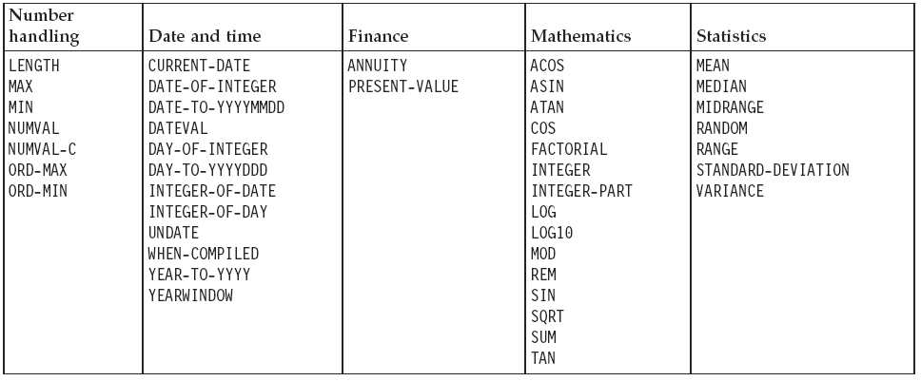
Numeric Intrinsic Functions – Another List
From the IBM Reference Manuals – another way of thinking about the different categories of Intrinsic Functions:

Slide 8
Processing table items using intrinsic functions
You can use intrinsic functions to process alphabetic, alphanumeric, national, or numeric table items.
  You can process DBCS data items only with the NATIONAL-OF intrinsic function.
  The data descriptions of the table items must be compatible with the requirements for the function arguments.
Use a subscript or index to reference an individual data item as a function argument.
  For example, assuming that Table-One is a 3 x 3 array of numeric items, you can find the square root of the middle element by using this statement:
  Compute X = Function Sqrt(Table-One(2,2))
You might often need to iteratively process the data in tables.
For intrinsic functions that accept multiple arguments, you can use the subscript ALL to reference all the items in the table or in a single dimension of the table.
  The iteration is handled automatically, which can make your code shorter and simpler.
You can mix scalars and array arguments for functions that accept multiple arguments: Compute Table-Median = Function Median(Arg1 Table-One(ALL))

Slide 9
COBOL Development
Course
Units:
Function Overview
Alphanumeric and National Functions
Date Functions
Numeric and Integer Functions
Appendices

Slide 10
Alphanumeric Intrinsic Functions
Divided into two categories:
  Alpha-only functions:
    Upper-case
    Lower-case
    Reverse
    Char
  Functions that can work on Alpha (PIC X) data – but also can work on other datatypes:
    Length
    MAX
    MIN
    Ord-Max
    Ord-Min
    Display-of
    Numval
    Numval-c
All of these are covered in the IBM manuals
We will go over only the most useful, and ones that are not entirely intuitive

Slide 11
Alphanumeric – Alpha-only functions
Upper-case
  The UPPER-CASE function returns a character string that contains the characters in the argument with each lowercase letter replaced by the corresponding uppercase letter.
    Move Function Upper(PICX-Variable1) to PICX-Variable2.
Lower-case
  The LOWER-CASE function returns a character string that contains the characters in the argument with each uppercase letter replaced by the corresponding lowercase letter.
    Move Function Lower(PICX-Variable1) to PICX-Variable2.
Reverse
  The REVERSE function returns a character string of exactly the same length as the argument, whose characters are exactly the same as those specified in the argument except that they are in reverse order.
    Move Function Reverse(PICX-Variable1) to PICX-Variable2.
Char
  The CHAR function returns a one-character alphanumeric value that is a character in the program collating sequence having the ordinal position equal to the value of the argument specified.
    Move Function Char(NumericVar) to PICX-Variable.

Slide 12
Alphanumeric – Length
Length
  The LENGTH function returns an integer equal to the length of the argument in national character positions for arguments of usage NATIONAL and in alphanumeric character positions or bytes for all other arguments. An alphanumeric character position and a byte are equivalent.
    Compute PIC9-Variable = Function Length(PICX-Variable)
The returned value is a nine-digit integer determined as follows:
  If argument-1 is an alphanumeric literal or an elementary data item of class alphabetic or alphanumeric, the value returned is equal to the number of alphanumeric character positions in the argument.
    The length of an alphanumeric data item or literal containing a mix of single-byte and double-byte characters is counted as though each byte were a single-byte character.
  If argument-1 is an alphanumeric group item, the value returned is equal to the length of argument-1 in alphanumeric character positions regardless of the content of the group.
    The returned value includes implicit FILLER positions, if any.

Slide 13
Alphanumeric – Max, Min, Ord-Max, Ord-Min
MAX
  The MAX function returns the content of the argument that contains the maximum value. Points:
    The arguments must be class alphabetic, alphanumeric, national, or numeric, and of the same class (except you can combine PIC A and PIC X )
    The returned value is the content of the arguments – either algebraically (if Numeric) or in collating sequence (if Alpha)
    If more than one argument-1 has the same greatest value, the leftmost argument-1 having that value is returned.
MIN
  The Min function returns the content of the argument that contains the minimum value. The same Points as MAX (above) apply.
  Examples:
    Move Function Max(Var1 Var2 Var3) to Receiving-Var
    Move Function Min(Var1 Var2 Var3) to Receiving-Var
Ord-Max and Ord-Min
  These two functions return a value that is the ordinal position in the argument list of the argument that contains either the maximum or minimum value – instead of the value itself.
    Compute recVar = Function Ord-Max(Var1, Var2, Var3).

Slide 14
Examples – Number casting (Numval and Numval-C)
Suppose you want to find the maximum value of two prices (represented below as alphanumeric items with dollar signs), put this value into a numeric field in an output record, and determine the length of the output record.
You can use NUMVAL-C (a function that returns the numeric value of an alphanumeric or national literal, or an alphanumeric or national data item) and the MAX and LENGTH functions to do so:
  01 X Pix 9(2).
  01 Price1 Pic x(8) Value "$8000".
  01 Price2 Pic x(8) Value "$2000".
  01 Output-Record.
  05 Product-Name Pic x(20).
  05 Product-Number Pic 9(9).
  05 Product-Price Pic 9(6).
  . . .
  Procedure Division.
  Compute Product-Price =
  Function Max (Function Numval-C (Price1) Function Numval-C (Price2))
  Compute X = Function Length (Output-Record)
Additionally, to ensure that the contents in Product-Name are in uppercase letters, you can use the following statement:
  Move Function Upper-case (Product-Name) to Product-Name

Slide 15
COBL Development
Course
Units:
Function Overview
Alphanumeric and National Functions
Date Functions
Numeric and Integer Functions
Appendices

Slide 16
Date Intrinsic Functions
Divided into two categories:
  Year2000 handling "windowing" – which refers to the logic needed to handle Y2K Century values (as sliding century windows), for date variables that only store the year as two digits.
    YEAR-TO-YYYY
    YEARWINDOW
    DAY-TO-YYYYDDD
    DATE-TO-YYYYMMDD
  Date (generic) handling and date math:
    CURRENT-DATE
    DATE-OF-INTEGER
    DATEVAL
    DAY-OF-INTEGER
    INTEGER-OF-DATE
    INTEGER-OF-DAY
    WHEN-COMPILED
Again, all of these are covered in the IBM manuals
And we will go over only the most useful, and ones that are not entirely intuitive
  But you will do a workshop with all of them ☺

Slide 17
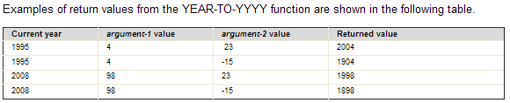
Date/Windowing – Year-to-YYYY
The YEAR-TO-YYYY function converts argument-1, a two-digit year, to a four-digit year.
  argument-2, when added to the year at the time of execution, defines the ending year of a 100-year interval, or sliding century window, into which the year of argument-1 falls.
  Notes:
    The function return type is integer.
    If the DATEPROC compiler option is in effect, then the returned value is an expanded date field with implicit DATE FORMAT YYYY.
    argument-1 - Must be a non-negative integer that is less than 100.
    argument-2 - Must be an integer.
      If argument-2 is omitted, the function is evaluated assuming the value 50 was specified.
    Compute YYYYres = Function Year-To-YYYY (YrVar)
    Compute YYYYres = Function Year-To-YYYY (YrVar WindowVar)
See Slide Notes on Year Window
Notes:
YEARWINDOW
If the DATEPROC compiler option is in effect, the YEARWINDOW function returns the starting year of the century window specified by the YEARWINDOW compiler option. The returned value is an expanded date field with implicit DATE FORMAT YYYY.
If the NODATEPROC compiler option is in effect, the YEARWINDOW function returns 0.

Slide 18
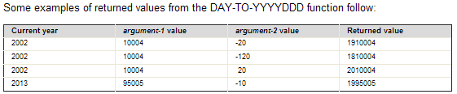
Date/Windowing – Day-to-YYYYDDD
DAY-TO-YYYYDDD (Julian Date to Julian Date windowing)
  The DAY-TO-YYYYDDD function converts argument-1 from a date with a two-digit year (YYnnn) to a date with a four-digit year (YYYYnnn). argument-2, when added to the year at the time of execution, defines the ending year of a 100-year interval, or sliding century window, into which the year of argument-1 falls.
  Notes:
    argument-1
      Must be zero or a positive integer less than 99367. The COBOL run time does not verify that the value is a valid date.
    argument-2
      Must be an integer. If argument-2 is omitted, the function is evaluated assuming the value 50 was specified.
    Compute Julian-with-Century =
      FUNCTION DAY-TO-YYYYDDD (Julian-DateVar).
      FUNCTION DAY-TO-YYYYDDD (Julian-DateVar WindowValueVar).

Slide 19
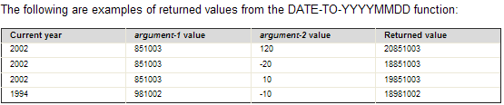
Date/Windowing – Date-to-YYYYDDD
DATE-TO-YYYYMMDD (Julian Date to Gregorian Date Windowing)
  The DATE-TO-YYYYMMDD function converts argument-1 from a date with a two-digit year (YYnnnn) to a date with a four-digit year (YYYYnnnn).
    argument-2, when added to the year at the time of execution, defines the ending year of a 100-year interval, or sliding century window, into which the year of argument-1 falls.
  Example:
  Compute YYYYMMDDVar = Function Date-To-YYYYMMDD(YYYYnnVar)

Slide 20
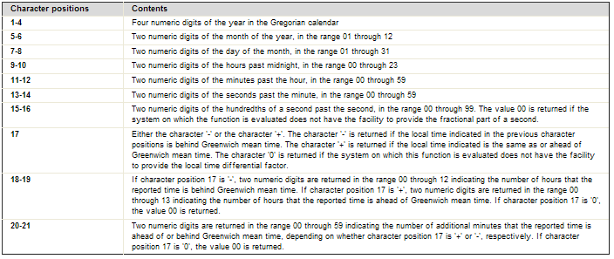
Current-Date and When-Compiled
The CURRENT-DATE and When-Compiled functions return a 21-character alphanumeric value that represents the calendar date, time of day, and time differential from Greenwich mean time provided by the system on which the function is evaluated.
  Move Function Current-Date to DateVar.
  Move Function When-Compiled to DateVar.
  DateVar is a 21 byte group field, with a layout as follows:
See Slide Notes for COBOL layout
Notes:
01 COBOL-DATE.
05 Cob-DATE.
10 Cob-YEAR PIC 9(4) Value 0.
10 Cob-MONTH PIC 99 Value 0.
10 Cob-DAY PIC 99 Value 0.
05 Cob-TIME.
10 Cob-HOUR PIC 99 Value 0.
10 Cob-MINUTES PIC 99 Value 0.
10 Cob-SECONDS PIC 99 Value 0.
10 Cob-SEC-HUND PIC 99 Value 0.
05 Cob-TIME-Difference.
10 GMT-DIR PIC X Value space.
10 GMT-HOUR PIC 99 Value 0.
10 GMT-MINUTES PIC 99 Value 0.

Slide 21
Date Math Functions
INTEGER-OF-DATE
  The INTEGER-OF-DATE function converts a date in the Gregorian calendar from standard date form (YYYYMMDD) to integer date form.
  The function result is an eight-digit integer that can be used to perform calendar arithmetic.
  Argument-1 must be an integer of the form YYYYMMDD, whose value is obtained from the calculation (YYYY * 10,000) + (MM * 100) + DD, where:
        YYYY represents the year in the Gregorian calendar.
        MM represents a month and must be a positive integer less than 13.
        DD represents a day and must be a positive integer less than 32, provided that it is valid for the specified month and year combination.
      Compute Integer-From = Function Integer-of-Date(YYYYMMDD)
DATE-OF-INTEGER
  The DATE-OF-INTEGER function converts a date in the Gregorian calendar from integer date form to standard date form (YYYYMMDD).
  The function result is an eight-digit date in the same format as the above Argument-1.
  Compute YYYYMMDD = Function Date-of-Integer(Integer-Form)

Slide 22
Example Date and math – Adding 90 Days
The following example shows how to calculate a due date that is 90 days from today.
  The first eight characters returned by the CURRENT-DATE function represent the date in a four-digit year, two-digit month, and two-digit day format (YYYYMMDD).
  The date is converted to its integer value; then 90 is added to this value and the integer is converted back to the YYYYMMDD format.
Example:
  01 YYYYMMDD Pic 9(8).
  01 Integer-Form Pic S9(9).
  . . .
  Move Function Current-Date(1:8) to YYYYMMDD
  Compute Integer-Form = Function Integer-of-Date(YYYYMMDD)
  Add 90 to Integer-Form
  Compute YYYYMMDD = Function Date-of-Integer(Integer-Form)
  Display 'Due Date: ' YYYYMMDD

Slide 23
COBOL Development
Course
Units:
Function Overview
Alphanumeric and National Functions
Date Functions
Numeric and Integer Functions
Appendices

Slide 24

Numeric Intrinsic Functions - Overview
You can use numeric intrinsic functions in places where numeric expressions are allowed.
Like the other Intrinsic functions, these can save you time because you don’t have to code the many common types of calculations that they provide.
Numeric intrinsic functions return a signed numeric value, and are treated as temporary numeric data items.
Numeric functions are classified into the following categories:
  Integer Those that return an integer
  Floating point Those that return a long (64-bit) or extended-precision (128-bit) floating-point value (depending on whether you compile using the default option ARITH(COMPAT) or using ARITH(EXTEND))
  Mixed Those that return an integer, a floating-point value, or a fixed-point number with decimal places, depending on the arguments
Benefits:
  By using built-in functions such as: Standard-Deviation, Annuity and Present-Value, you can future-proof your applications, and simplify coding, testing and maintenance
There are more procedurally practical ways to look at the Numeric Intrinsic Functions (next slide)

Slide 25
Three Sub-Categories of Numeric Functions
Finance
(pure) Mathematics
Statistics
Note that several of the other Intrinsic Functions not specifically in the Numeric list are available on Numeric types:
  Max/Min/Range
  Ord-Max/Ord-Min
  Length

Slide 26
Finance – 1 of 2
Business investment decisions frequently require computing the present value of expected future cash inflows to evaluate the profitability of a planned investment.
The present value of an amount that you expect to receive at a given time in the future is that amount, which, if invested today at a given interest rate, would accumulate to that future amount.
  For example, assume that a proposed investment of $1,000 produces a payment stream of $100, $200, and $300 over the next three years, one payment per year respectively.
  The following COBOL statements calculate the present value of those cash inflows at a 10% interest rate:
  01 Series-Amt1 Pic 9(9)V99 Value 100.
  01 Series-Amt2 Pic 9(9)V99 Value 200.
  01 Series-Amt3 Pic 9(9)V99 Value 300.
  01 Discount-Rate Pic S9(2)V9(6) Value .10.
  01 Todays-Value Pic 9(9)V99.
  . . .
  Compute Todays-Value =
  Function Present-Value(Discount-Rate Series-Amt1 Series-Amt2 Series-Amt3)

Slide 27
Finance – 2 of 2
You can use the ANNUITY function in business problems that require you to determine the amount of an installment payment (annuity) necessary to repay the principal and interest of a loan.
The series of payments is characterized by an equal amount each period, periods of equal length, and an equal interest rate each period.
  The following example shows how you can calculate the monthly payment required to repay a $15,000 loan in three years at a 12% annual interest rate (36 monthly payments, interest per month = .12/12):
  01 Loan Pic 9(9)V99.
  01 Payment Pic 9(9)V99.
  01 Interest Pic 9(9)V99.
  01 Number-Periods Pic 99.
  . . .
  Compute Loan = 15000
  Compute Interest = .12
  Compute Number-Periods = 36
  Compute Payment =
  Loan * Function Annuity((Interest / 12) Number-Periods)

Slide 28
(Pure) Math Functions – 1 of 2
Sum
  The SUM function returns a value that is the sum of the arguments.
    The function type depends on the argument types, as follows:
      All integers → Integer result
      Mixed integers and decimal → Decimal result
    Compute answr = Function Sum(Numvar1 Numvar2 Numvar3)
Sqrt
  The SQRT function returns a numeric value that approximates the square root of the argument specified.
  Compute answr = Function Sqrt(Numvar1)
Factorial
  The FACTORIAL function returns an integer that is the factorial of the argument specified.
    If the value of argument-1 is zero, the value 1 is returned; otherwise, the factorial of argument-1 is returned.
  Compute answr = Function Factorial(Numvar1)

Slide 29
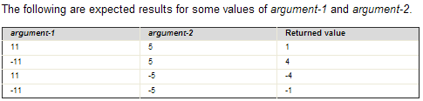
(Pure) Math Functions – 2 of 2
Mod
  The MOD function returns an integer value that is: argument-1 modulo argument-2.
    The function result is an integer with as many digits as the shorter of argument-1 and argument-2.
      argument-1 - Must be an integer.
      argument-2 - Must be an integer and must not be zero.
    Compute answr = Function Mod(Intvar1 Intvar2)
Rem
  The REM function returns a numeric value that is the remainder of argument-1 divided by argument-2.
      argument-1 - Must be class numeric.
      argument-2 - Must be class numeric and must not be zero.
  Compute answr = Function Rem(Numvar1 Numvar2)
Slide Notes
Notes:
MOD and REM are so close it is amazing, these are the formulas:
MOD = argument-1 - (argument-2 * FUNCTION INTEGER (argument-1 / argument-2))
REM = argument-1 - (argument-2 * FUNCTION INTEGER-PART (argument-1 / argument-2))

Slide 30
Statistics – Intrinsic Functions – Max, Min, Ord-Max, Ord-Min
MAX/Min
  The MAX function returns the content of the argument that contains the algebraically maximum value and MIN returns the minimum value. Points:
    The arguments must all be class numeric
    The returned value type is numeric and either integer (if all the arguments are integer, or numeric class – if there are any decimal type definitions)
    If more than one argument-1 has the same greatest value, the leftmost argument-1 having that value is returned.
  Examples:
    Compute reslt = Function Max(NumVar1 NumVar2 NumVar3)
    Compute reslt Function Min(NumVar1 NumVar2 NumVar3)
Ord-Max and Ord-Min
  These two functions return a value that is the ordinal position in the argument list of the argument that contains either the max or min algebraic value.
    Compute reslt = Function Ord-Max(Var1, Var2, Var3).
Range
  The RANGE function returns a value that is equal to the value of the maximum argument minus the value of the minimum argument.
  The function type depends on the argument types all of which must be numeric:
  Example:
    Compute reslt = Function Range(NumVar1 NumVar2 NumVar3)

Slide 31
Statistics – Intrinsic Functions – Random
Random
  The RANDOM function returns a numeric value that is a pseudorandom number from a rectangular distribution.
    The returned value is exclusively between zero and one.
      PIC V99
    If argument-1 is specified, it must be zero or a positive integer. However, only values in the range from zero up to and including 2,147,483,645 yield a distinct sequence of pseudorandom numbers.
    If a subsequent reference specifies argument-1, a new sequence of pseudorandom numbers is started – beginning with the same result.
    If the first reference to this function in the run unit does not specify argument-1, the seed value used will be zero.
    In each case, subsequent references without specifying argument-1 return the next number in the current sequence.
    For a given seed value, the sequence of pseudorandom numbers is always the same
    Compute rslt = Function Random (NumVar1)

Slide 32
Statistics – Intrinsic Functions – Mean, Median, Range
The following COBOL statement demonstrates that you can nest intrinsic functions, use arithmetic expressions as arguments, and perform previously complex calculations simply:
  Compute answr = Function Log(Function Sqrt(2 * X + 1))
  + Function Rem(X 2)
  Here in the addend the intrinsic function REM (instead of a DIVIDE statement with a REMAINDER clause) returns the remainder of dividing X by 2.
Intrinsic functions make calculating statistical information easier.
Assume you are analyzing various city taxes and want to calculate the mean, median, and range (the difference between the maximum and minimum taxes):
  01 Tax-S Pic 99v999 value .045.
  01 Tax-T Pic 99v999 value .02.
  01 Tax-W Pic 99v999 value .035.
  01 Tax-B Pic 99v999 value .03.
  01 Ave-Tax Pic 99v999.
  01 Median-Tax Pic 99v999.
  01 Tax-Range Pic 99v999.
  . . .
  Compute Ave-Tax = Function Mean(Tax-S Tax-T Tax-W Tax-B)
  Compute Median-Tax = Function Median(Tax-S Tax-T Tax-W Tax-B)
  Compute Tax-Range = Function Range(Tax-S Tax-T Tax-W Tax-B)

